Slide 1
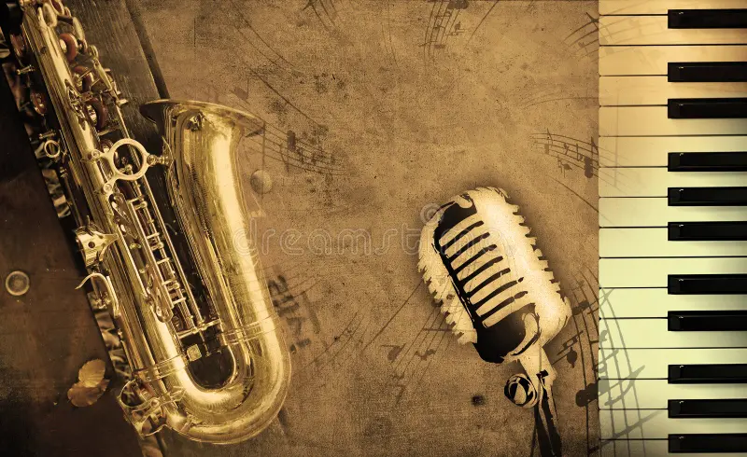
MUSIC GENRE
CLASSIFICATION
BHAVANA M
PRAKHYATH B S
Audios Co. Streaming App | January 2020
01

Slide 2
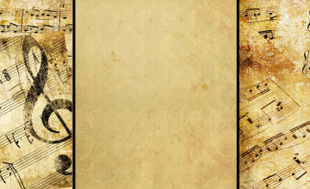
PROBLEM STATEMENT
Develop a machine learning model to classify music tracks into genre categories using audio features and corresponding visual representations of sound, exploring the relationship between acoustic characteristics and visual patterns in music.
08
DATASET DETAILS
The dataset consists of audio files of music tracks along with corresponding genre labels. Additionally, the dataset includes image files that visually represent the sound of each track. This multimodal dataset provides an opportunity to explore the relationship between audio features, visual representations of sound, and genre classifications.
02

Slide 3
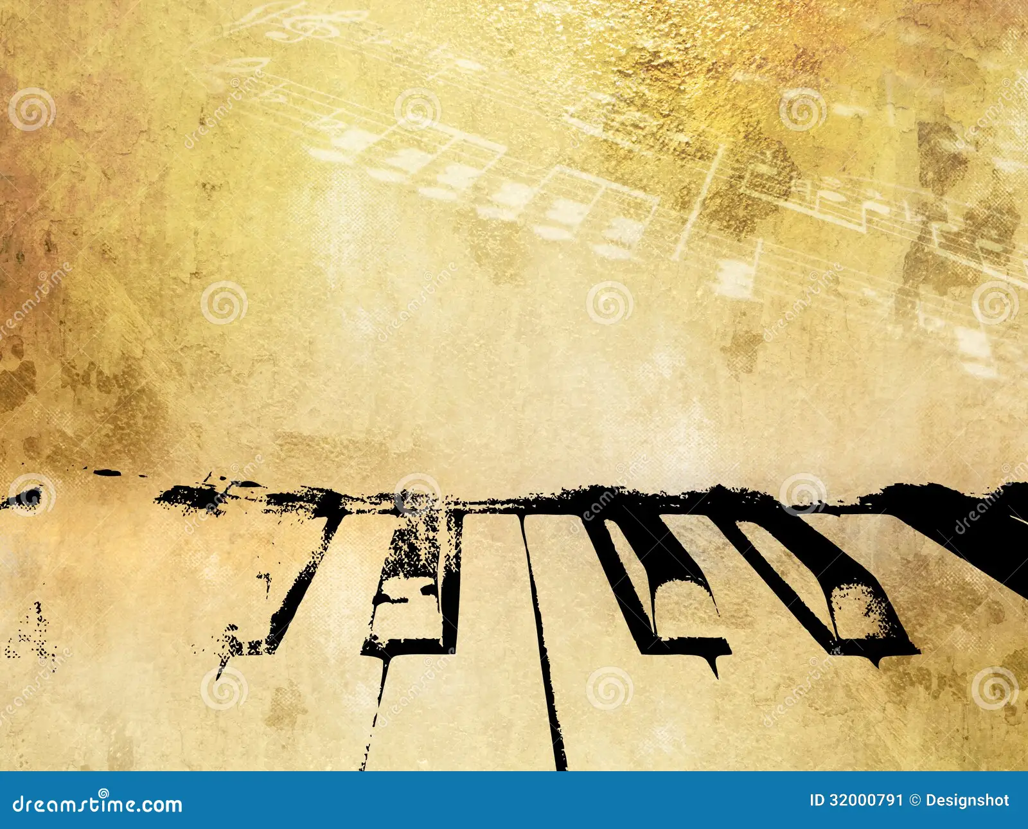
OVERVIEW OF DATASET
The dataset used for music genre classification is a curated collection known as the "genres original," based on the famous GTZAN dataset, which is considered the MNIST (benchmark) of sound datasets. It consists of:
Audio Files:
10 genres represented by 100 audio files each.
Each audio file has a fixed length of 30 seconds, providing standardized data for analysis.
Visual Representations (Mel Spectrograms):
Visual representations (images) were created for each audio file using Mel Spectrograms.
Mel Spectrograms convert audio signals into visual representations suitable for input into convolutional neural networks (CNNs), facilitating audio classification using image-based approaches.
CSV Files - Audio Features:
Two CSV files containing extracted audio features:
One file includes mean and variance computed over multiple features extracted from 30-second audio segments.
Another file follows a similar structure but uses 3-second audio segments, significantly increasing the dataset size for model training.
03

Slide 4
OVERVIEW OF DATASET
Dataset Utilization:
The dataset is structured to support music genre classification tasks, with audio features and visual representations serving as inputs for machine learning models.
Splitting audio files into shorter segments (3-second clips) enhances data diversity and model training efficiency.
Purpose and Impact:
This dataset enables exploration of sound analysis, visualization techniques, and music genre classification using machine learning algorithms.
By combining audio features, Mel Spectrograms, and metadata in CSV format, researchers can develop and evaluate classification models for diverse music genres.
Availability and Relevance:
The dataset is publicly available and widely used in the research community for benchmarking and comparing music genre classification algorithms.
It aligns with the goal of understanding and differentiating music based on acoustic characteristics and visual representations, contributing to advancements in music information retrieval.
source is the below link.
https://www.kaggle.com/datasets/andradaolteanu/gtzan-dataset-music-genre-classification
04

Slide 5
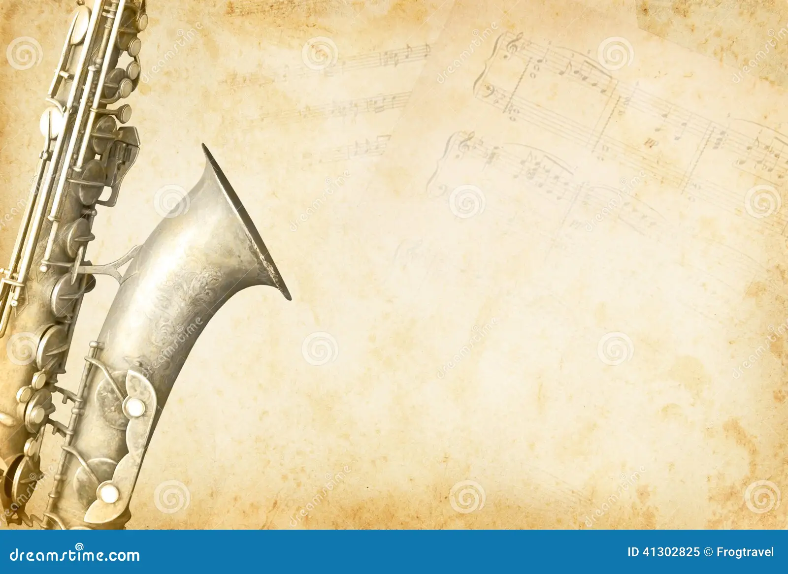
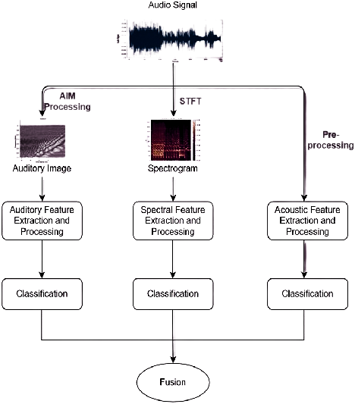

PROPOSED
METHODOLOGY
05

Slide 6
IMPLEMENTATION DETAILS
Libraries Used: The implementation of the project relies on several Python libraries:
- Pandas and NumPy for data manipulation.
- Matplotlib for data visualization.
- Librosa for audio processing and feature extraction.
- Scikit-learn for data preprocessing and model evaluation.
- TensorFlow and Keras for building and training neural network models.
Model Architecture: The classification model is constructed using a sequential neural network architecture, comprising dense layers with rectified linear unit (ReLU) activation functions. Dropout layers are incorporated to mitigate overfitting.
Preprocessing Steps:
- Loading and preprocessing audio data using Librosa, including resampling and normalization.
- Extracting audio features such as spectral features, chroma features, and zero-crossing rate.
- Generating Mel Spectrograms for visual representations of sound.
- Scaling features using StandardScaler to ensure uniformity and numerical stability.
06

Slide 7
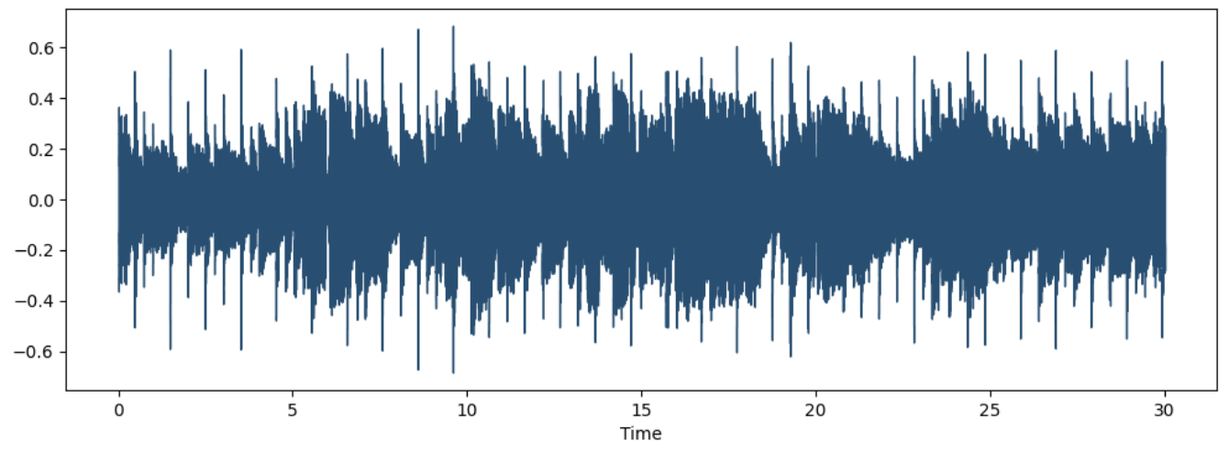
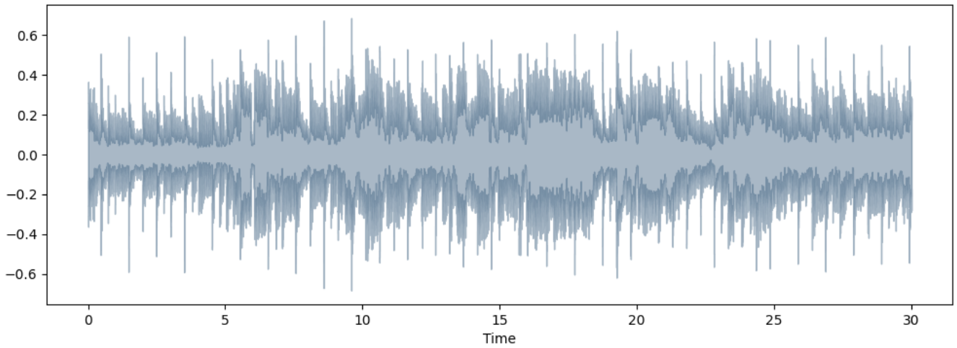
VISUALIZING AUDIO FILES
RAW WAVE
SPECTRAL ROLLOF

Slide 8
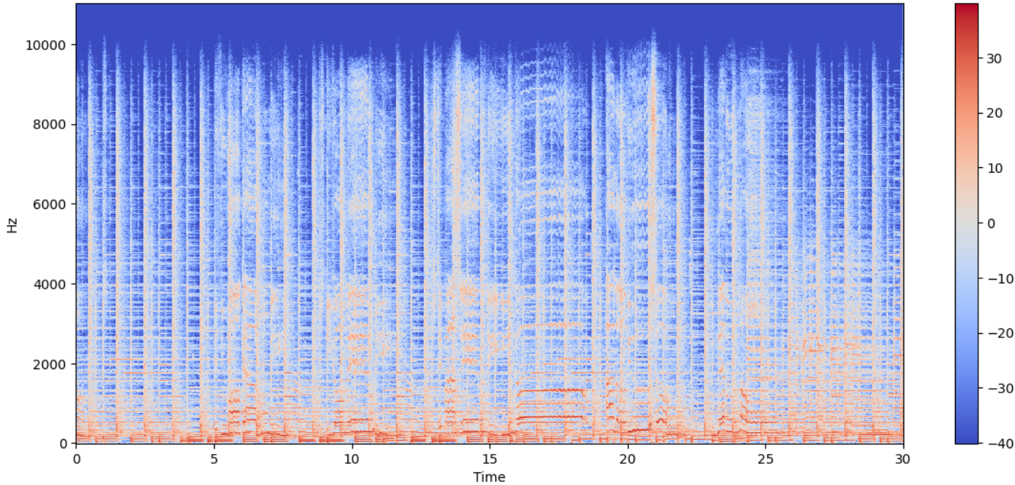
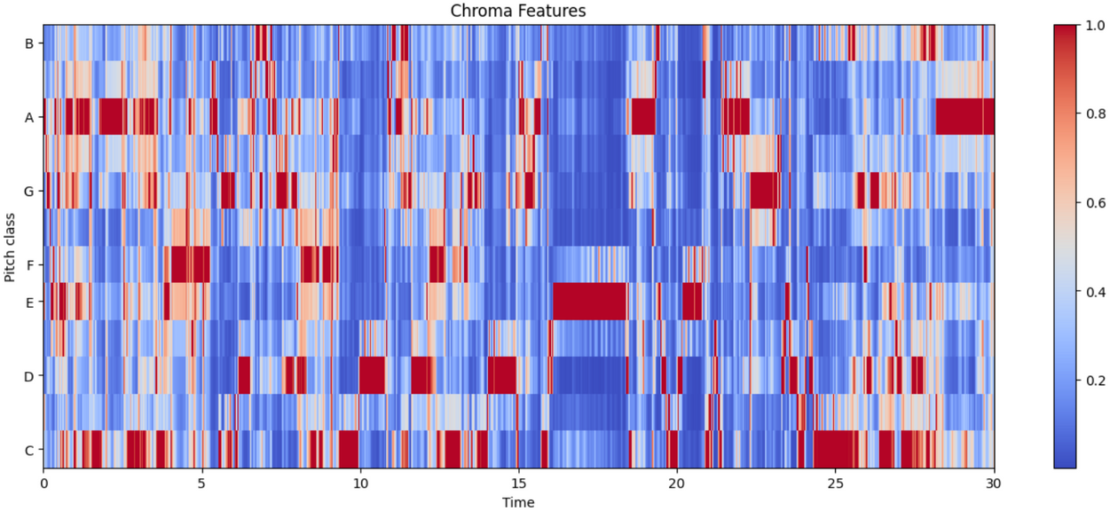
SPECTOGRAMS
CHROMA FEATURE

Slide 9
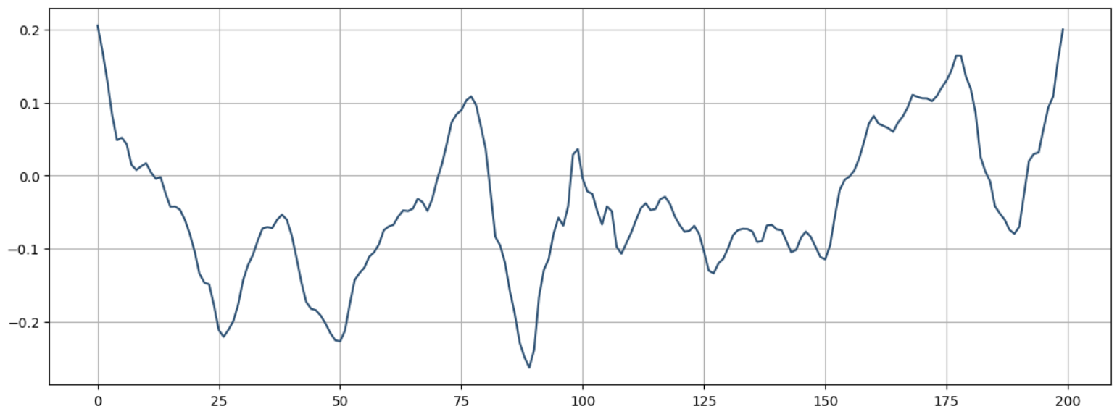
ZERO CROSSING RATES
09

Slide 10
FEATURE SELECTION, FEATURE IMPORTANCE, AND DATA SPLITTING
Feature Selection:
Comprehensive audio features extracted.
Utilization of Mel Spectrograms for visual features.
Feature Importance:
Logistic Regression and Extra Trees Classifier used to assess feature importance.
Coefficients and impurity decrease values evaluated.
Data Splitting:
Stratified splitting to ensure balanced class distribution.
80:20 train-test split ratio adopted for model training and evaluation.
10

Slide 11
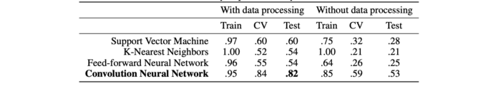
MODEL TRAINING AND EVALUATION
Model Training
The model is trained using the Adam optimizer with a sparse categorical crossentropy loss function. The training process involves iterating over multiple epochs while monitoring validation accuracy to prevent overfitting.
Model Evaluation
The trained model is evaluated on the test dataset to assess its performance in classifying music genres. Evaluation metrics include accuracy, precision, recall, and F1-score.
ACCURACY OF PREDICTIONS.
11

Slide 12
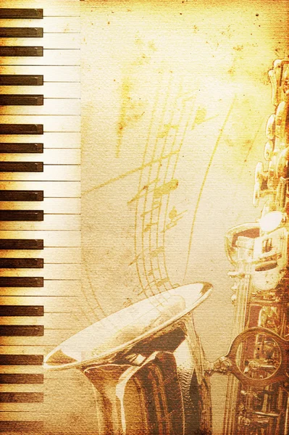

Conclusion
In conclusion, the music genre classification project demonstrates the effectiveness of machine learning techniques in analyzing and categorizing audio data. By combining audio features and visual representations of sound, the model achieves significant accuracy in genre classification tasks. Future work may involve exploring additional feature extraction methods, experimenting with different model architectures, and incorporating ensemble learning techniques for further improvement.
12

Slide 13
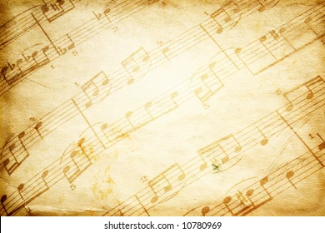
REFERENCES
https://www.clairvoyant.ai/blog/music-genre-classification-using-cnn.
https://github.com/derekahuang/Music-Classification https://cs229.stanford.edu/proj2018/report/21.pdf https://towardsdatascience.com/extract-features-of-music-75a3f9bc265d https://www.clairvoyant.ai/blog/music-genre-classification-using-cnn https://medium.com/bisa-ai/music-genre-classification-using-convolutional-neural-network-7109508ced47
https://www.kaggle.com/datasets/andradaolteanu/gtzan-dataset-music-genre-classification/download?datasetVersionNumber=1
13

Slide 14
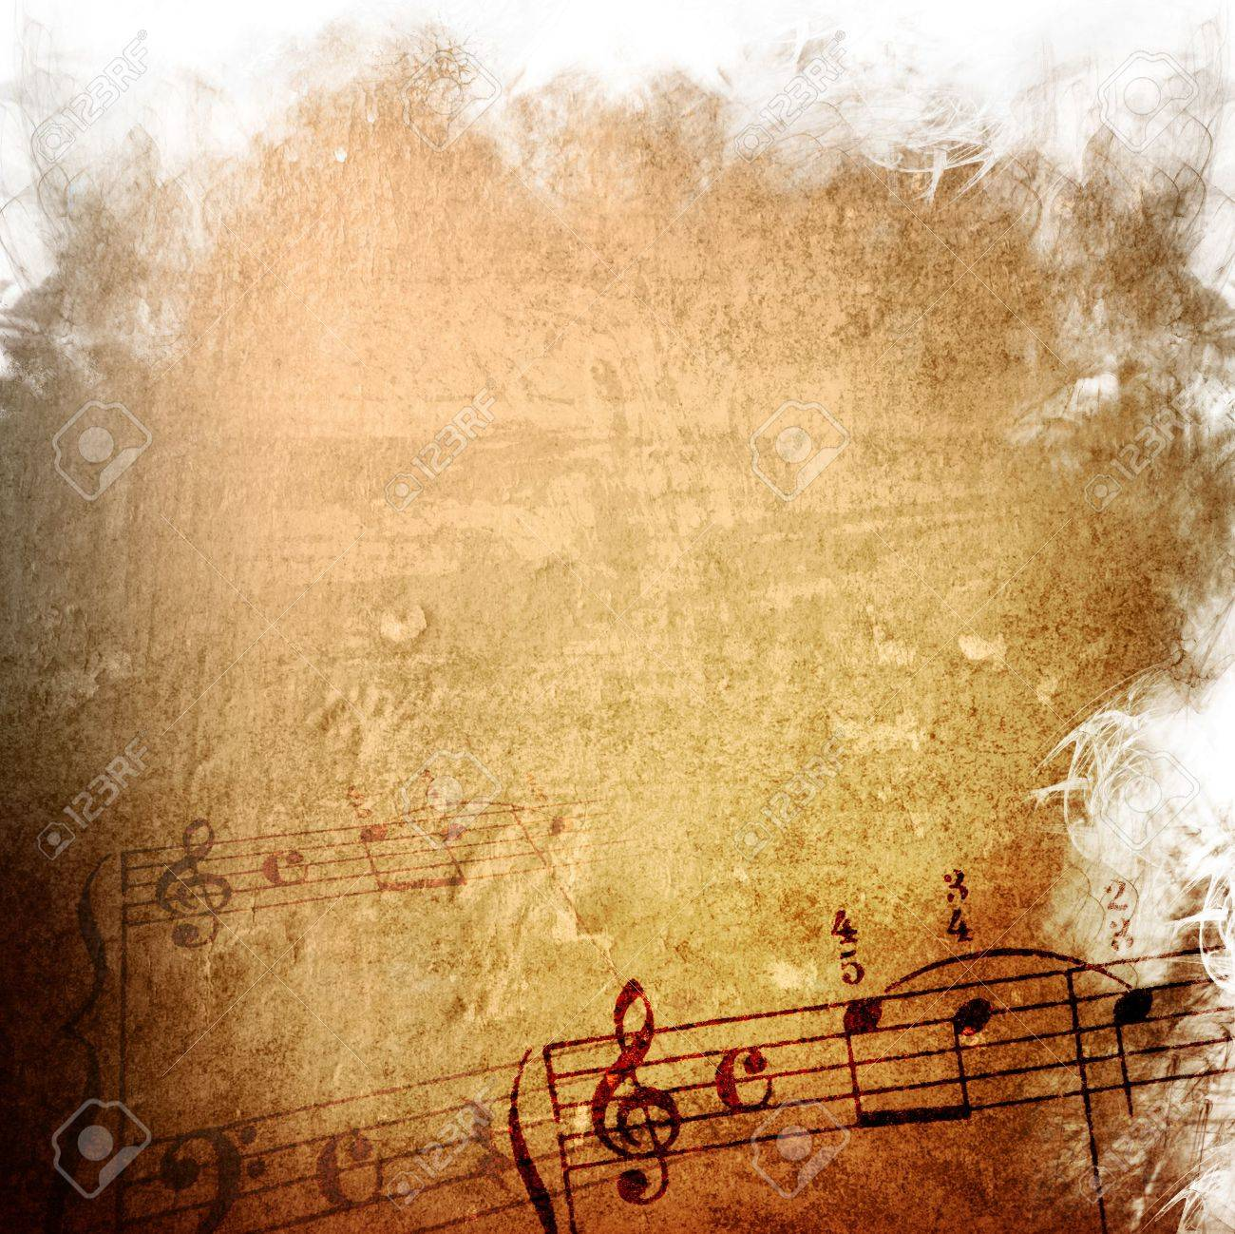
Founder and Music Lover
THANK
YOU
14

